Slide 1


Neuron Model and Network architecture
Hamidreza Baradaran Kashani
Neural Networks Course (Fall 2022)
1

Slide 2
Objectives
Studying the mathematical model of neuron
Getting familiar with activation function (transfer function)
Interconnecting neurons to form various network architectures
Building Single-layer and Multilayer networks
2

Slide 3
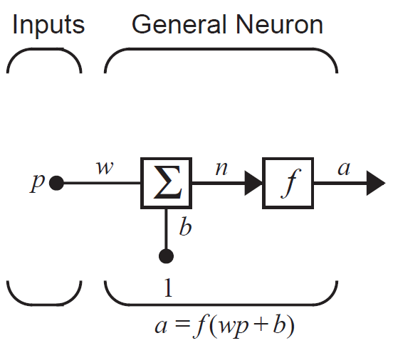
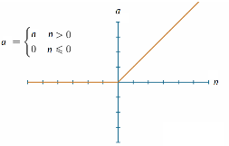
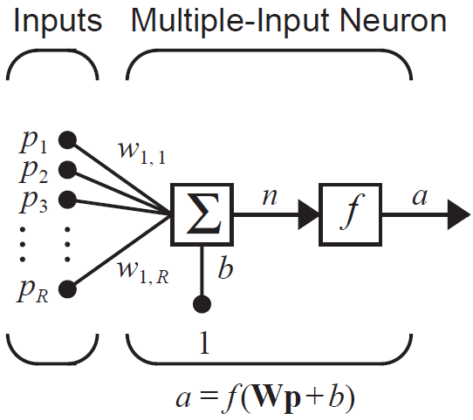
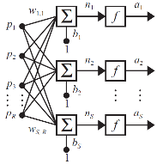
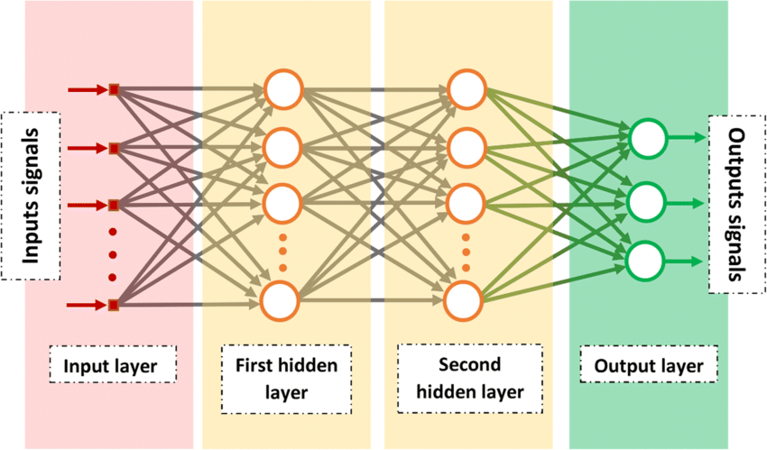
List of Contents
Single-Input Neuron
Activation Function
Multiple-Input Neuron
Single-layer Network
Multilayer Network
3

Slide 4
Notation
Scalars: small italic letters a,b,c
Vectors: small bold nonitalic letters a,b,c
Matrices: capital BOLD nonitalic letters A,B,C
4

Slide 5
Single-Input Neuron
p: scalar input
w: scalar weight
b: bias
n: net input
f : activation function
(transfer function)
a: scalar output
5

Slide 6
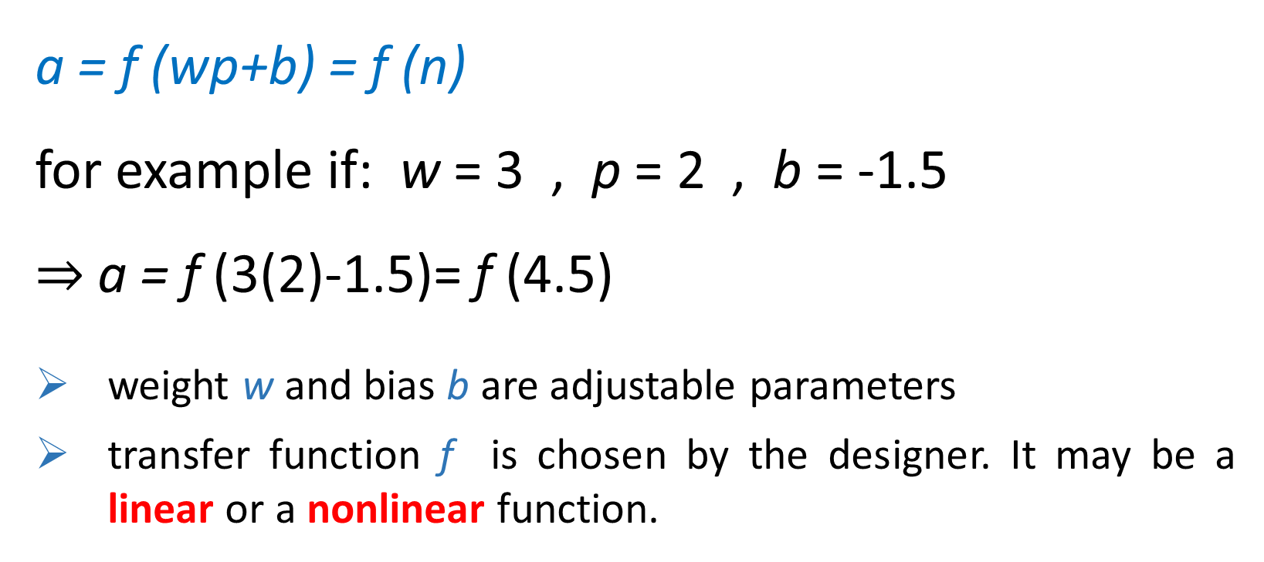
Single-Input Neuron
a = f (wp+b) = f (n)
for example if: w = 3 , p = 2 , b = -1.5
$⇒$a = f (3(2)-1.5)= f (4.5)
weight w and bias b are adjustable parameters
transfer function f is chosen by the designer. It may be a linear or a nonlinear function.
6

Slide 7
Activation Function
Unit step (Hard Limit) Activation function
If the argument is less than 0, the output will be 0
If the argument is greater than or equal to 0, the output will be 1
We use this function to create neurons that classify inputs into two distinct categories.
7

Slide 8
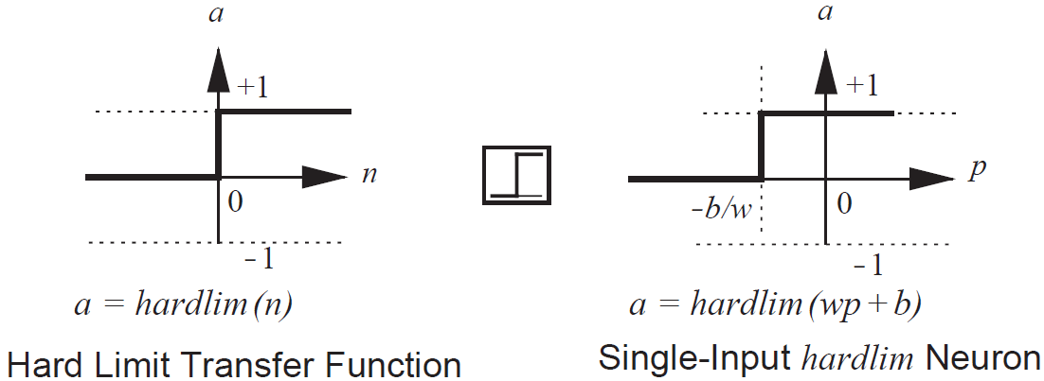
Activation Function
Unit step (Hard Limit) Activation function
8
Notes:
We will use this function to create neurons that classify inputs into two distinct categories. It will be used extensively in Chapter 4.
نام دیگر آن Binary Step است و اگر خروجی آن 1- و 1+ باشد Bipolar step می گوییم.
البته چون این دو تابع مشتق پذیر نیستند در یادگیری های مبتنی بر گرادیان قابل استفاده نیستند. لذا از نسخه های نرم این تابع معمولا استفاده می کنیم مثل

Slide 9

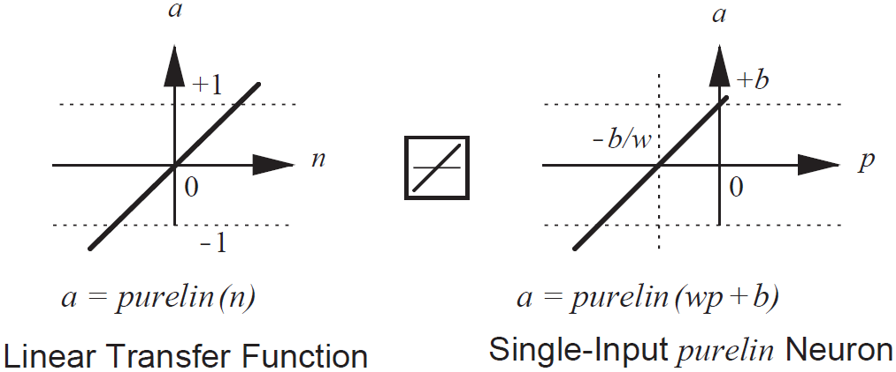
Activation Function
Linear Activation function
The output of this function is its argument
9
Notes:
Neurons with this transfer function are used in the ADALINE networks, which are discussed in Chapter 10.
تابع خطی یا identity function بیشترین کاربرد در لایه آخر شبکه های رگرسیون هست اگر نخواهیم خروجی ما محدودیت خاصی داشته باشد.

Slide 10
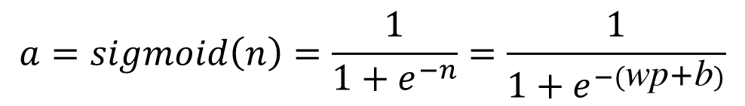
Activation Function
Sigmoid Activation function
This function takes the input between minus and plus infinity
and gives the output in the range 0 to 1
This Activation function is commonly used in multilayer networks because it is differentiable
$$a=sigmoid\left(n\right)=\frac{1}{1+ⅇ^{−n}}=\frac{1}{1+ⅇ^{−(\text{wp}\text{+}\text{b})}}$$
10

Slide 11
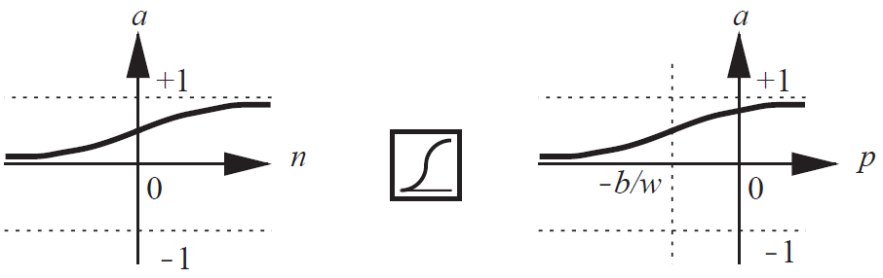
Activation Function
Sigmoid Activation function
a = sigmoid (n)
Sigmoid Transfer Function
a = sigmoid (wp + b)
Single-Input sigmoid Neuron
11
Notes:
کاربردشان بیشتر در شبکه های MLP در لایه های مخفی است. البته مشکلشان آن است که مشتق شان کمتر از یک است و اگر تعداد لایه های شبکه خیلی زیاد باشد می تواند باعث مشکل محو گرادیان شوند.
The Sigmoid function, historically used in hidden layers, was eventually replaced by the Rectified Linear Units activation function (or ReLU).

Slide 12
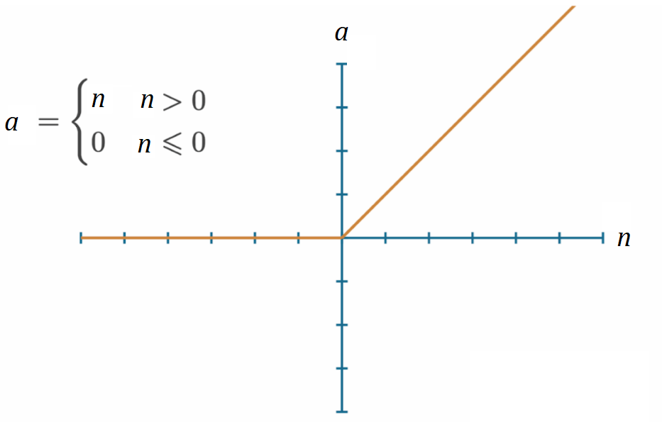
Activation Function
ReLU Activation function
12
Notes:
شاید معروفترین این توابع انتقال همین تابع relu است که دیگر آن مشکل محو شدگی گرادیان بخصوی برای آن لایه های عقبی یا اولیه را ندارد چون مشتقش زیر 1 نیست.
یکی از اصلی ترین توابع در شبکه های CNN است.

Slide 13
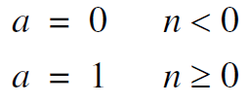




Activation Function
Transfer Function | Input/Output Relation | Icon | abbreviation
Hard Limit |  |  | hardlim
Symmetrical Hard Limit |  |  | hardlims
Linear |  |  | linear
13

Slide 14


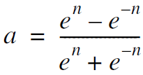



Activation Function
Transfer Function | Input/Output Relation | Icon | abbreviation
Sigmoid |  |  | sigmoid
Hyperbolic Tangent Sigmoid |  |  | tanh
Rectified Linear Unit |  |  | ReLU
14

Slide 15
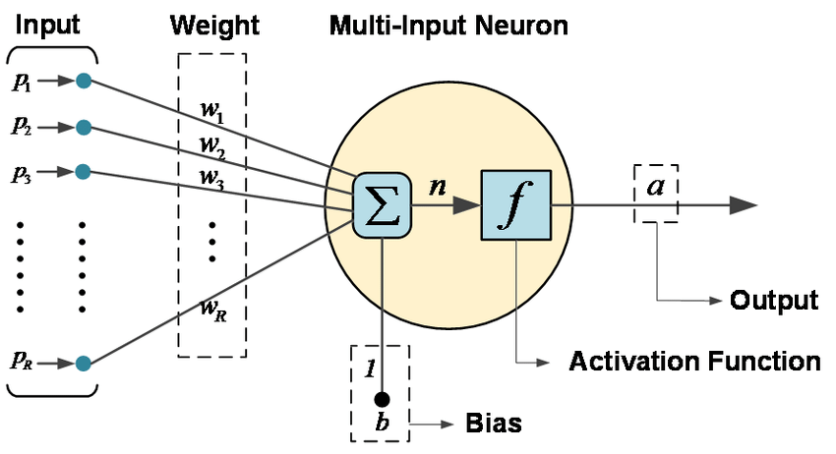
Multiple-Input Neuron
15

Slide 16


Multiple-Input Neuron
A neuron with R inputs:
W is the weight matrix which has 1 row (single neuron) and R columns
16

Slide 17
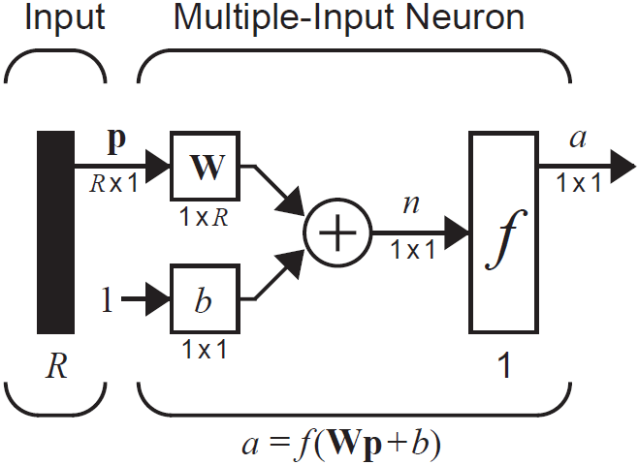
Multiple-Input Neuron
abbreviated notation:
17

Slide 18
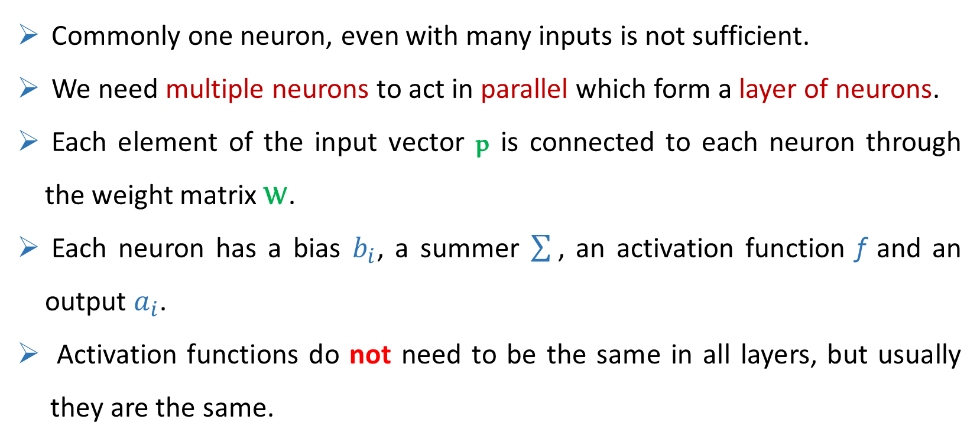
Single-layer network
Commonly one neuron, even with many inputs is not sufficient.
We need multiple neurons to act in parallel which form a layer of neurons.
Each element of the input vector p is connected to each neuron through the weight matrix W.
Each neuron has a bias $b_{i}$, a summer , an activation function f and an output $a_{i}$.
Activation functions do not need to be the same in all layers, but usually they are the same.
18

Slide 19
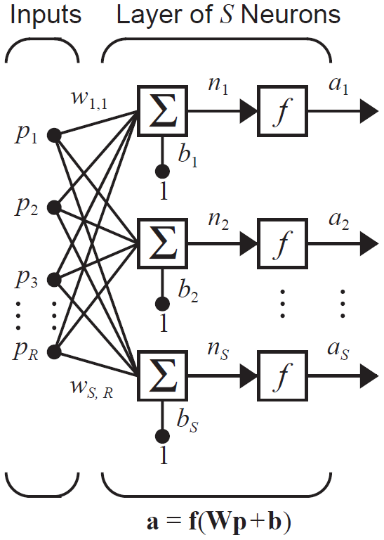
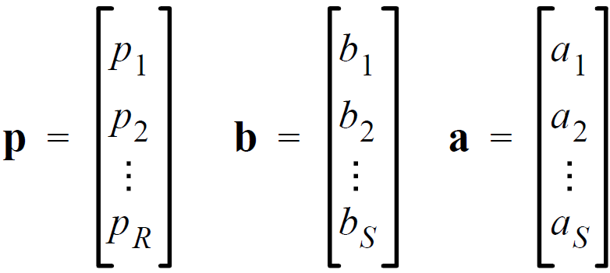
Single-layer network
a single-layer of S neurons:
19

Slide 20
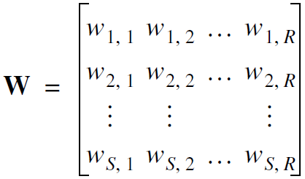
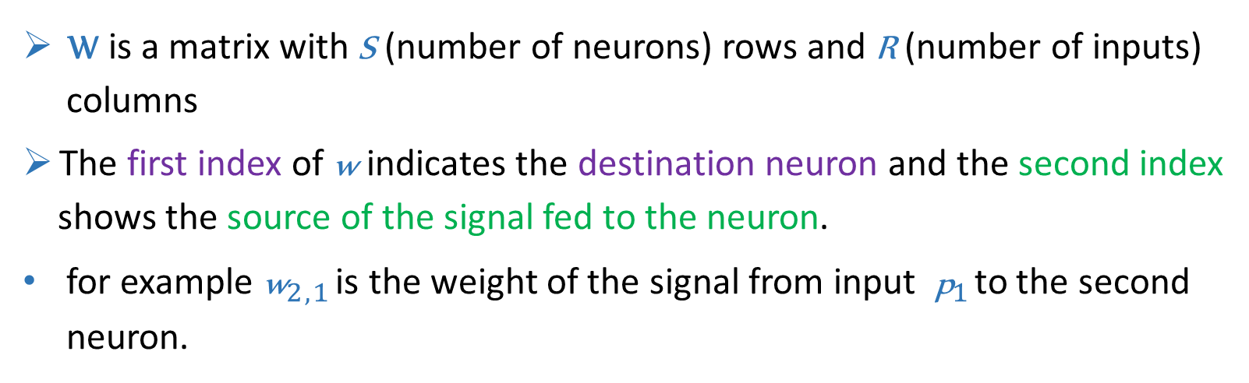
Single-layer network
W is a matrix with S (number of neurons) rows and R (number of inputs)
columns
The first index of w indicates the destination neuron and the second index
shows the source of the signal fed to the neuron.
for example w$_{2 , 1}$ is the weight of the signal from input p$_{1}$ to the second
neuron.
20

Slide 21
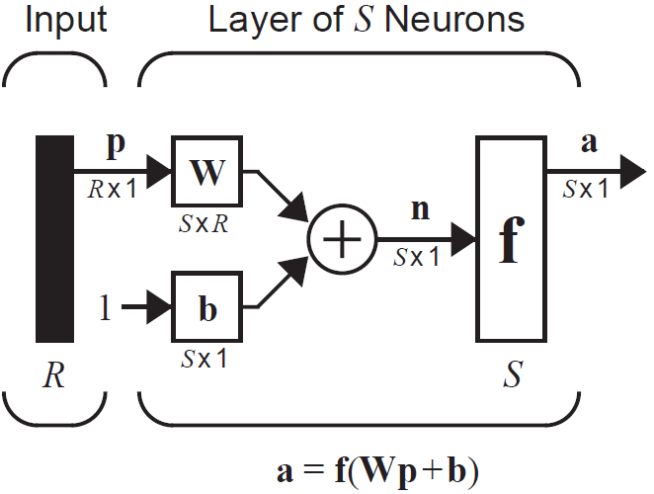
Single-layer network
a single-layer of S neurons (abbreviated notation):
p: input vector
W: weight matrix
b: bias vector
n: net input vector
f : activation functions
a: output vector
21

Slide 22
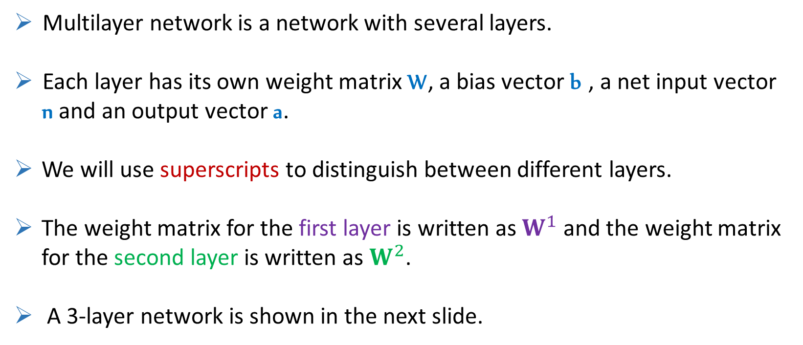
Multilayer Network
Multilayer network is a network with several layers.
Each layer has its own weight matrix W, a bias vector b , a net input vector
n and an output vector a.
We will use superscripts to distinguish between different layers.
The weight matrix for the first layer is written as $W^{1}$ and the weight matrix
for the second layer is written as $W^{2}$.
A 3-layer network is shown in the next slide.
22

Slide 23
Multilayer Network
23

Slide 24
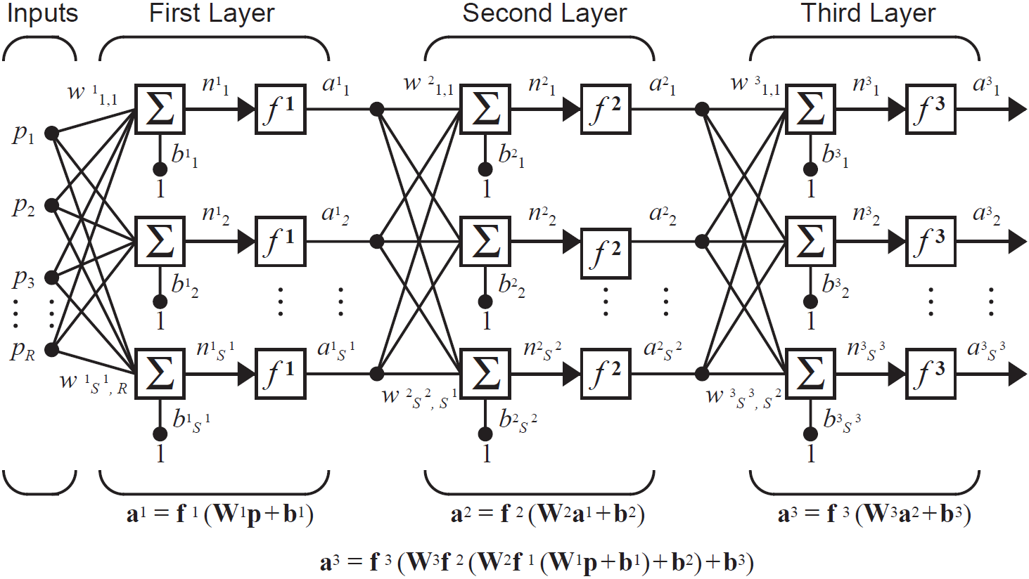
Multilayer Network
24

Slide 25
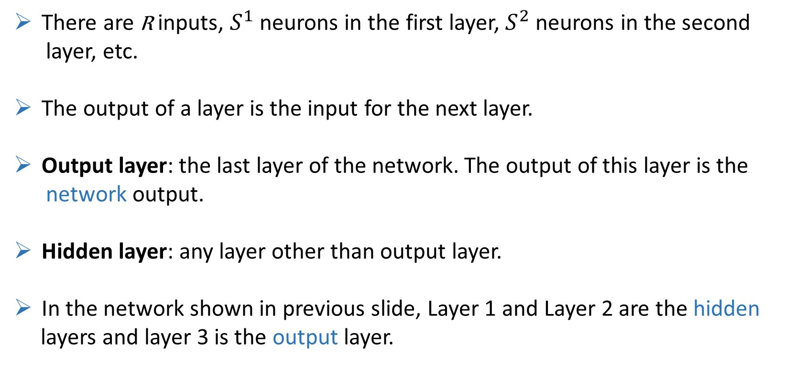
Multilayer Network
There are R inputs, $S^{1}$ neurons in the first layer, $S^{2}$ neurons in the second
layer, etc.
The output of a layer is the input for the next layer.
Output layer: the last layer of the network. The output of this layer is the
network output.
Hidden layer: any layer other than output layer.
In the network shown in previous slide, Layer 1 and Layer 2 are the hidden
layers and layer 3 is the output layer.
25

Slide 26
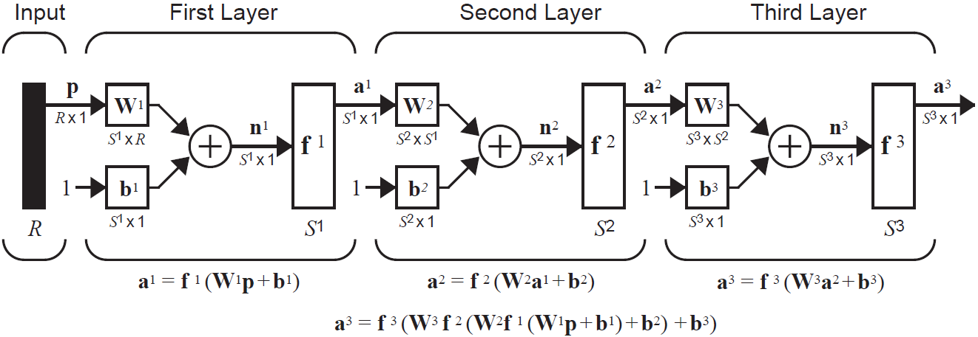
Multilayer Network
a 3-layer network (abbreviated notation):
26

Slide 27
Multilayer Network
Multilayer networks are more powerful than single-layer networks. For instance, a two-layer network having a sigmoid first layer and a linear second layer can be trained to approximate most functions arbitrarily well.
The bias gives the network an extra variable. So a network with biases would be more powerful than those without.
For instance, a neuron without a bias will always have a net input n of zero when the network inputs p are zero.
27

Slide 28
Multilayer Network
The number of inputs to the network and the number of outputs from the network (number of neurons in the output layer) are defined by external problem specifications.
The desired characteristics of the output signal also help to select the transfer function for the output layer.
For instance if an output is to be either -1 or 1, then a symmetrical hard limit (hardlims) transfer function should be used.
The external problem does not tell you directly the number of neurons required in the hidden layers.
28

Slide 29
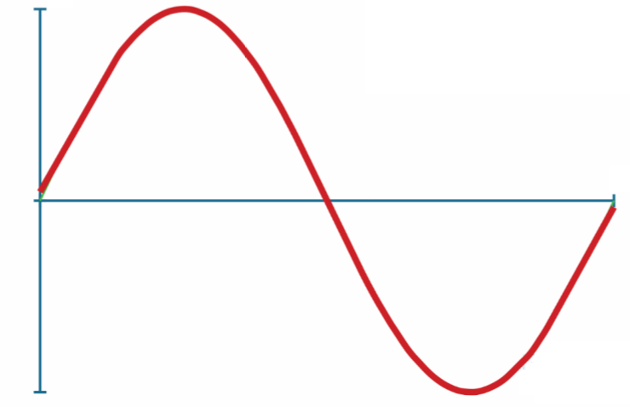
Multilayer Network
Neural Networks are function approximators. To obtain some intuition, we want to approximate a sine wave by a neural network with two hidden layers which both of them have ReLU activation function. The output layer uses the Linear activation function.
We begin by 2 neurons in each hidden layer which are not fully connected. As we increase the number of neurons in hidden layers, the approximation becomes more accurate.
29

Slide 30
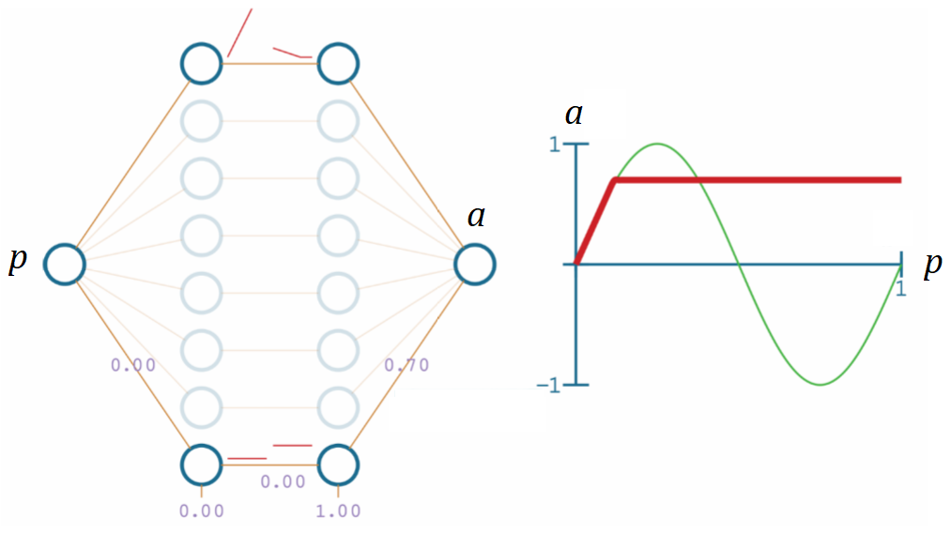
Multilayer Network
Two neurons in each hidden layer (not fully connected)
30
Notes:
بایاس نرون های لایه اول نقش شیفت تابع تولید شده در راستای افقی را دارند
و بایاس نرون های لایه دوم نقش شیفت تابع تولید شده در راستای عمودی را دارند
وزن ها روی شیب تابع تخمینی تاثیر دارند. وزن های منفی می توانند شیب های منفی ایجاد کنند.

Slide 31
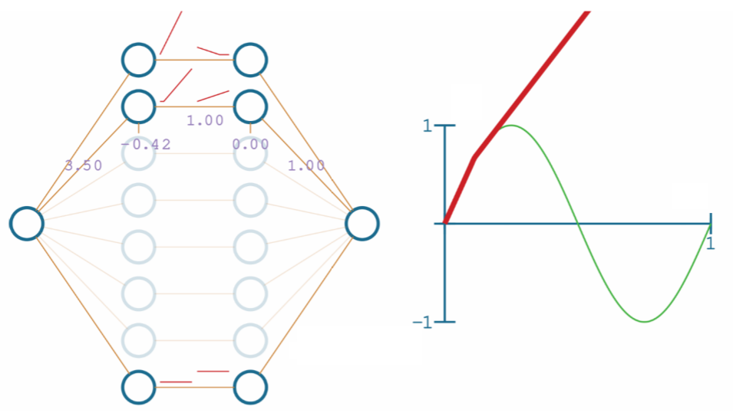
Multilayer Network
Three neurons in each hidden layer (not fully connected)
31

Slide 32
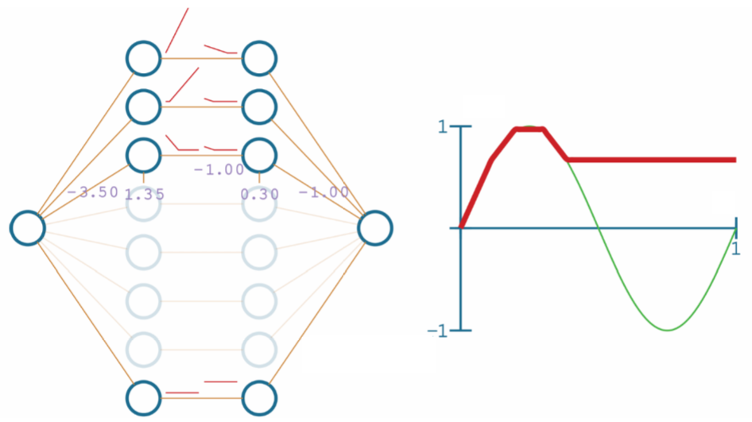
Multilayer Network
Four neurons in each hidden layer (not fully connected)
32

Slide 33
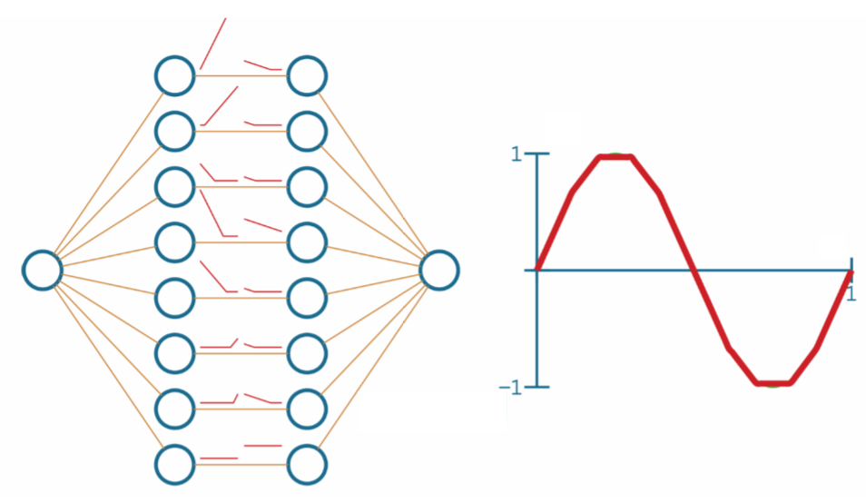
Multilayer Network
Eight neurons in each hidden layer (not fully connected)
33

Slide 34
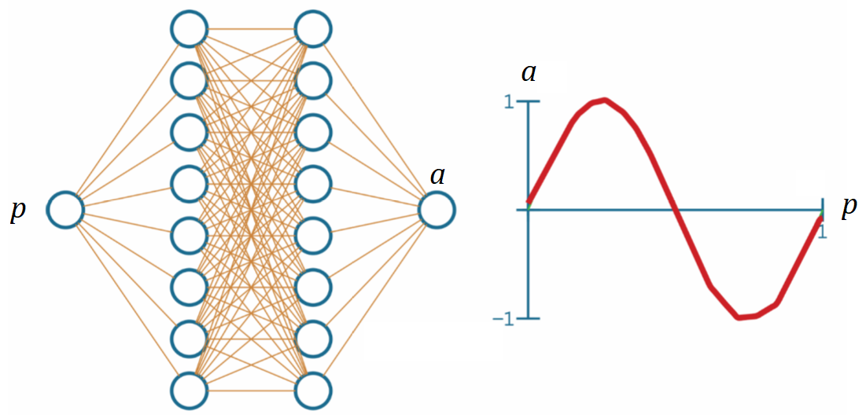
Multilayer Network
Eight neurons in each hidden layer (fully connected)
34

Slide 35
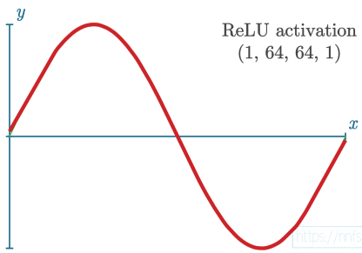
Multilayer Network
64 neurons in each hidden layer (fully connected)
35

Slide 36

Thanks for your attention
End of chapter 2
Hamidreza Baradaran Kashani
36

